Slide 1
Team members:
Nafis Faiyaz
Student ID : 180041101
Farhan Ishmam
Student ID : 180041120
Sidratul Muntaha
Student ID : 180041118
“
1

Slide 2

HOUSING PRICE PREDICTOR
2

Slide 3
CONTENTS
Introduction to the project
Motivation and Objectives
Project details
Timeline
Future Work
3

Slide 4
What is the Housing Price Predictor?
A useful software to get a quick and easy estimation
of the real price of your property.
4

Slide 5
MOTIVATION AND OBJECTIVES
Creating transparency between the seller and the buyer.
Minimize the struggle in finding houses in new areas.
Nearly perfect estimation of the cost according to our needs.
Saving time.
5

Slide 6
Targeted Users
Buyers
Sellers
Professionals
6

Slide 7

Project Details
7

Slide 8
Breaking down the Project
Planning
Matrix Functions
Gradient Descent Algorithm
Training The Model
User Interface
Visualization through graph
8

Slide 9
Steps followed:
Housing Price Predictor
6)Evaluating and presenting the results
2)Gathering the Data
3)Building the model
4)Predicting the price
5)Producing the graphs
1)Selecting the model
9

Slide 10
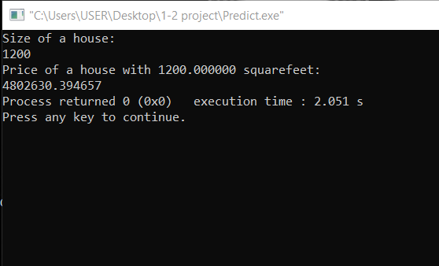
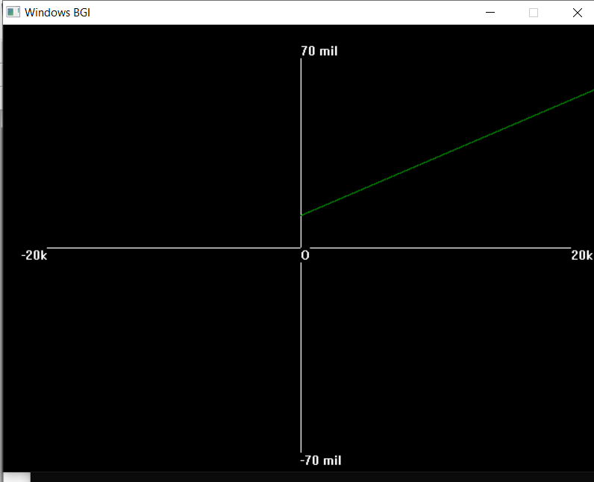
Features
Accurate price estimation based on size.
Visual data representation though graphs along with a user interface
10

Slide 11

TIMELINE
11

Slide 12
What we planned to do
12

Slide 13
2019
Jul
Aug
Sep
Oct
2019
Planning and analysis
Jul 16 - Jul 24
Today
Creating Matrix-functions
Jul 25 - Aug 15
Gradient-descend-algorithm
Aug 16 - Aug 31
Graphics
Sep 1 - Sep 8
Feeding data and creating test model
Sep 9 - Sep 17
Make necessary changes on test model
Sep 18 - Sep 30
Implement further goals
Oct 1 - Oct 15
13

Slide 14
What we did
14

Slide 15
2019
Jul
Aug
Sep
Oct
2019
Planning and Analysis
Jul 16 - Jul 23
Matrix-Functions
Jul 24 - Sep 07
Gradient-Descend-Algorithm
Sep 8 - Sep 16
Today
Implementation-Training
Sep 16- Sep 23
Graph Representation
Sep 24 - Oct 5
User Interface
Oct 5 - Oct 14
15
1

Slide 16
FUTURE WORK
More features
Space for rent
More data
Commercial spaces
Web based trading system
16

Slide 17

THANKS
Q/A
17

